Slide 1

Data Structures and Algorithms
Big O Notation

Slide 2
Big O notation
The most fundamental tools for computer scientists to analyze the cost of an algorithm.
It measures the time it takes to run your function as the input grows.

Slide 3
Complexity
Two parts to measuring efficiency.
Time complexity - measure of how long the function takes to run in terms of its computational steps.
Space complexity - has to do with the amount of memory used by the function.

Slide 4
Example
Total # minutes to treat patients is depended on # of patients
No of patients | Total time (min)
1 | 10
2 | 20
4 | 40
Big O(n)
Big O(# of patients)
Notes:
Time Complexity is defined as the number of times a particular instruction set is executed rather than the total time taken.
It is because the total time took also depends on some external factors like the compiler used, processor’s speed, etc.
Space Complexity is the total memory space required by the program for its execution.

Slide 5
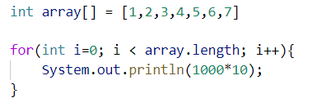
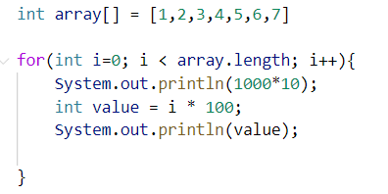
O(n) - Linear
Execute n times
O(N)
O(1)
O(1)
O(1)
O(N)

Slide 6
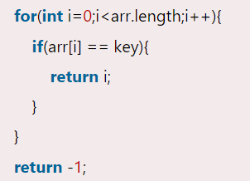
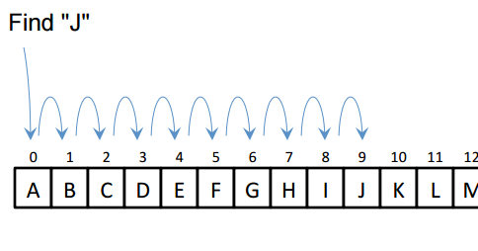

Example
Linear search algorithm
In worst-case scenario, this is not very efficient.
Time complexity - O(N)

Slide 7
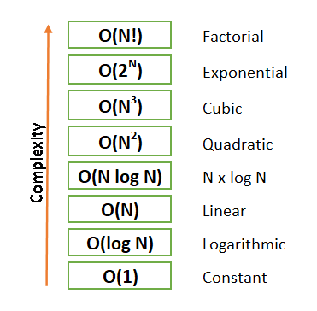




O(1) - Constant time
O(1)
O(n)
O(1)
O(N) + O(1) => O(N)

Slide 8
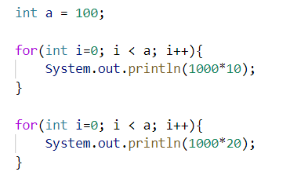
O(n) - Linear
What is the time complexity of this code?

Slide 9
O(n)
What is the time complexity of this code?
O(n)
= O(n) + O(n)
= O(2n)
Time complexity = O(n)
O(n)

Slide 10
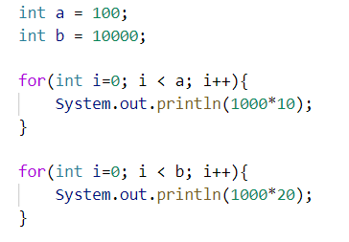
O(n)
What is the time complexity of this code?
O(a)
= O(a) + O(b)
= O(a+b)
Time complexity = O(a+b)
O(b)

Slide 11
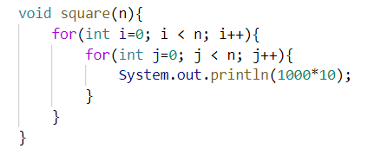
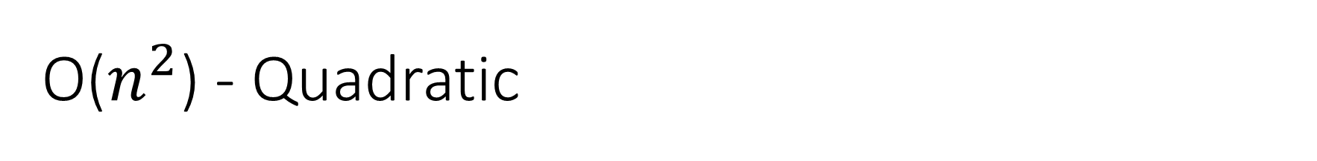


O($n^{2}$) - Quadratic
O(n)
O($n^{2}$)
Time complexity = O($n^{2}$)

Slide 12
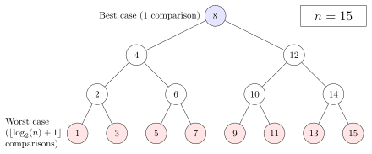
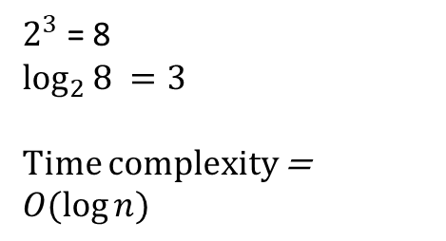
O(log n) - logarithmic
If there were 8 elements:
$2^{3}$ = 8
$$\log_{2}{8} =3$$
Time complexity =
$$O(log{n)}$$

Slide 13



O(log n)
logFunction(8)
$$\text{Time} \text{complexity} \text{=}O(log{n)}$$
Iteration 1
logFunction(4)
Iteration 2
logFunction(2)
Iteration 3
logFunction(1)

Slide 14
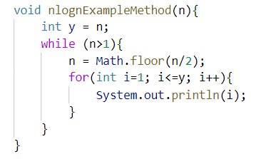
O(nlogn)
If n=4
n = 4
4/2 = 2
for loop
n = 2
2/2 = 1
for loop
O(logn)
for loop 1
for loop 1
O(nlogn)
for loop 2
for loop 2
O(n)
O(n)
for loop 3
for loop 3
Time complexity = O(n*logn)
for loop 4
for loop 4

Slide 15
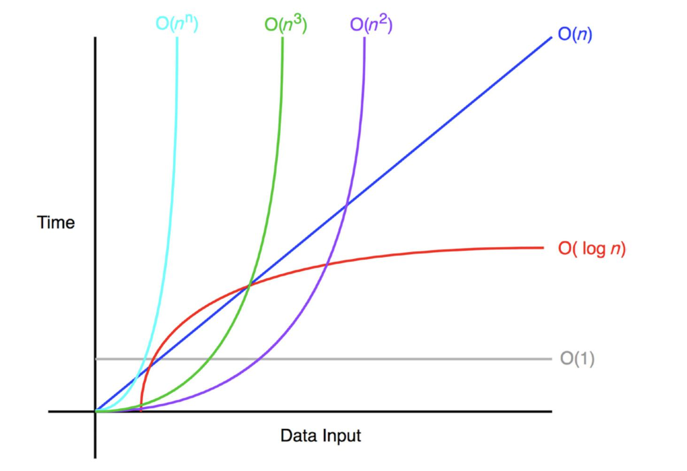

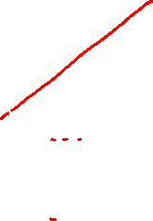
Time complexity – Order of growth

Slide 16
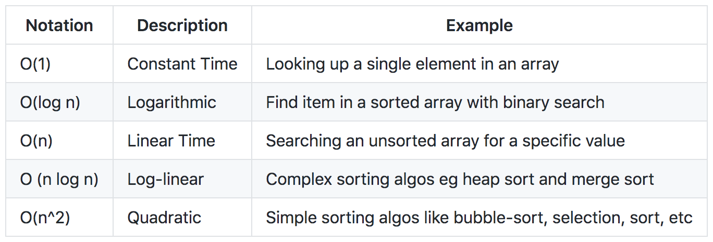
Time complexity

Slide 17
Thank You

